Slide 1
ONLINE LEARNING
7TH FEBRUARY 2020

Slide 2
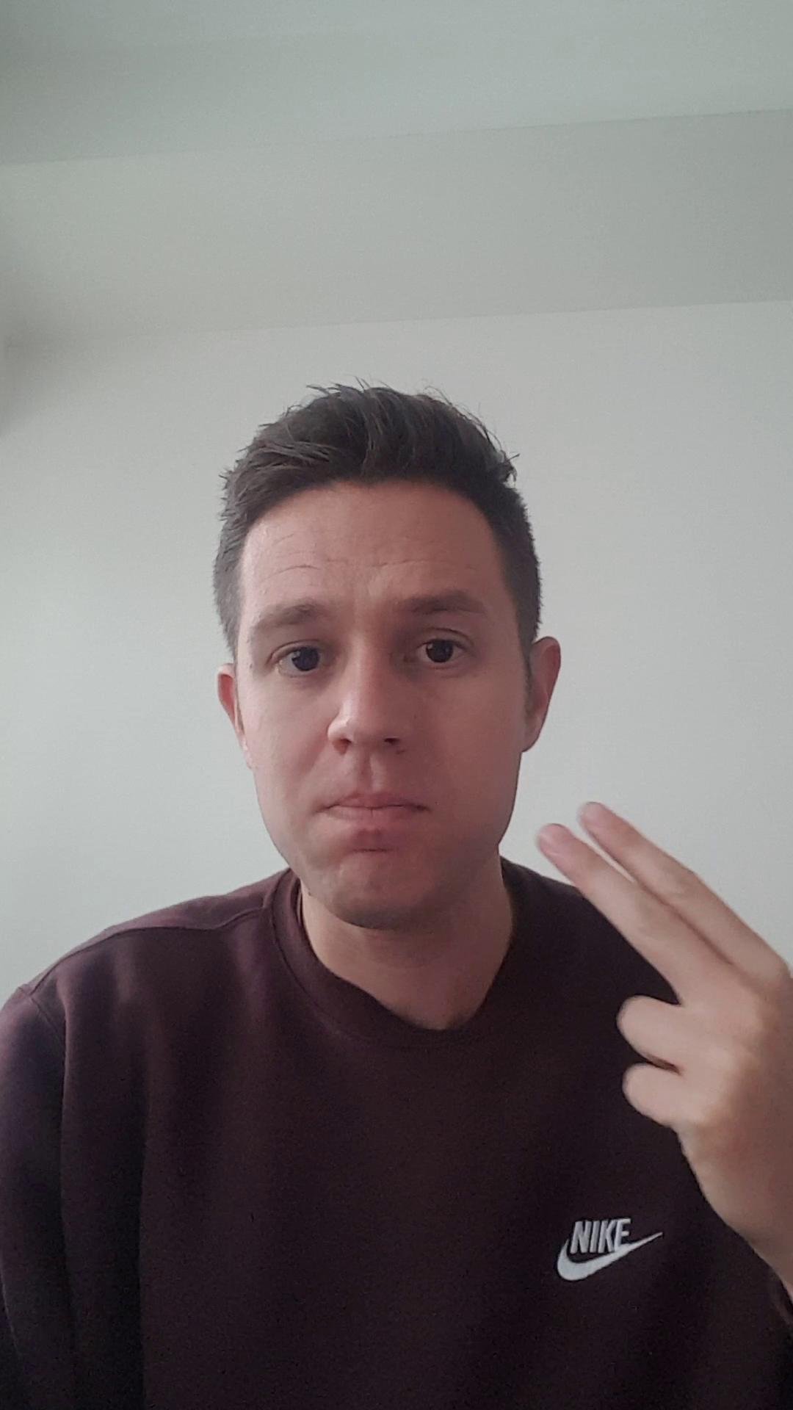

Slide 3
THINGS YOU WILL NEED
Grammar Friends book
Mr Popper’s Penguins
Pencil, rubber and a highlighter
Blank paper
Lined paper

Slide 4
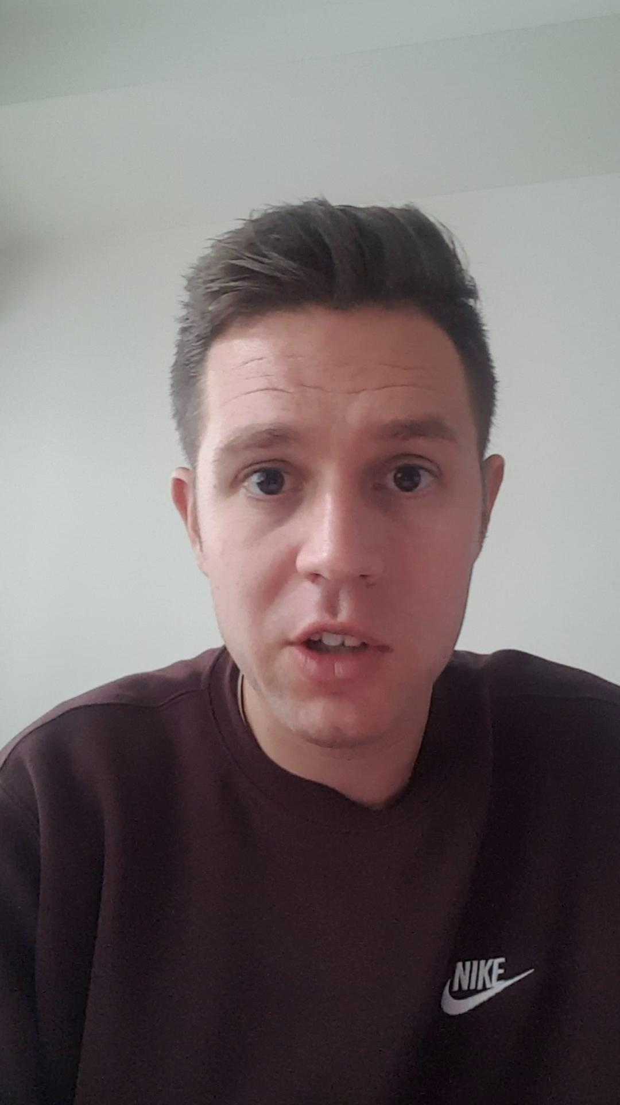

Slide 6
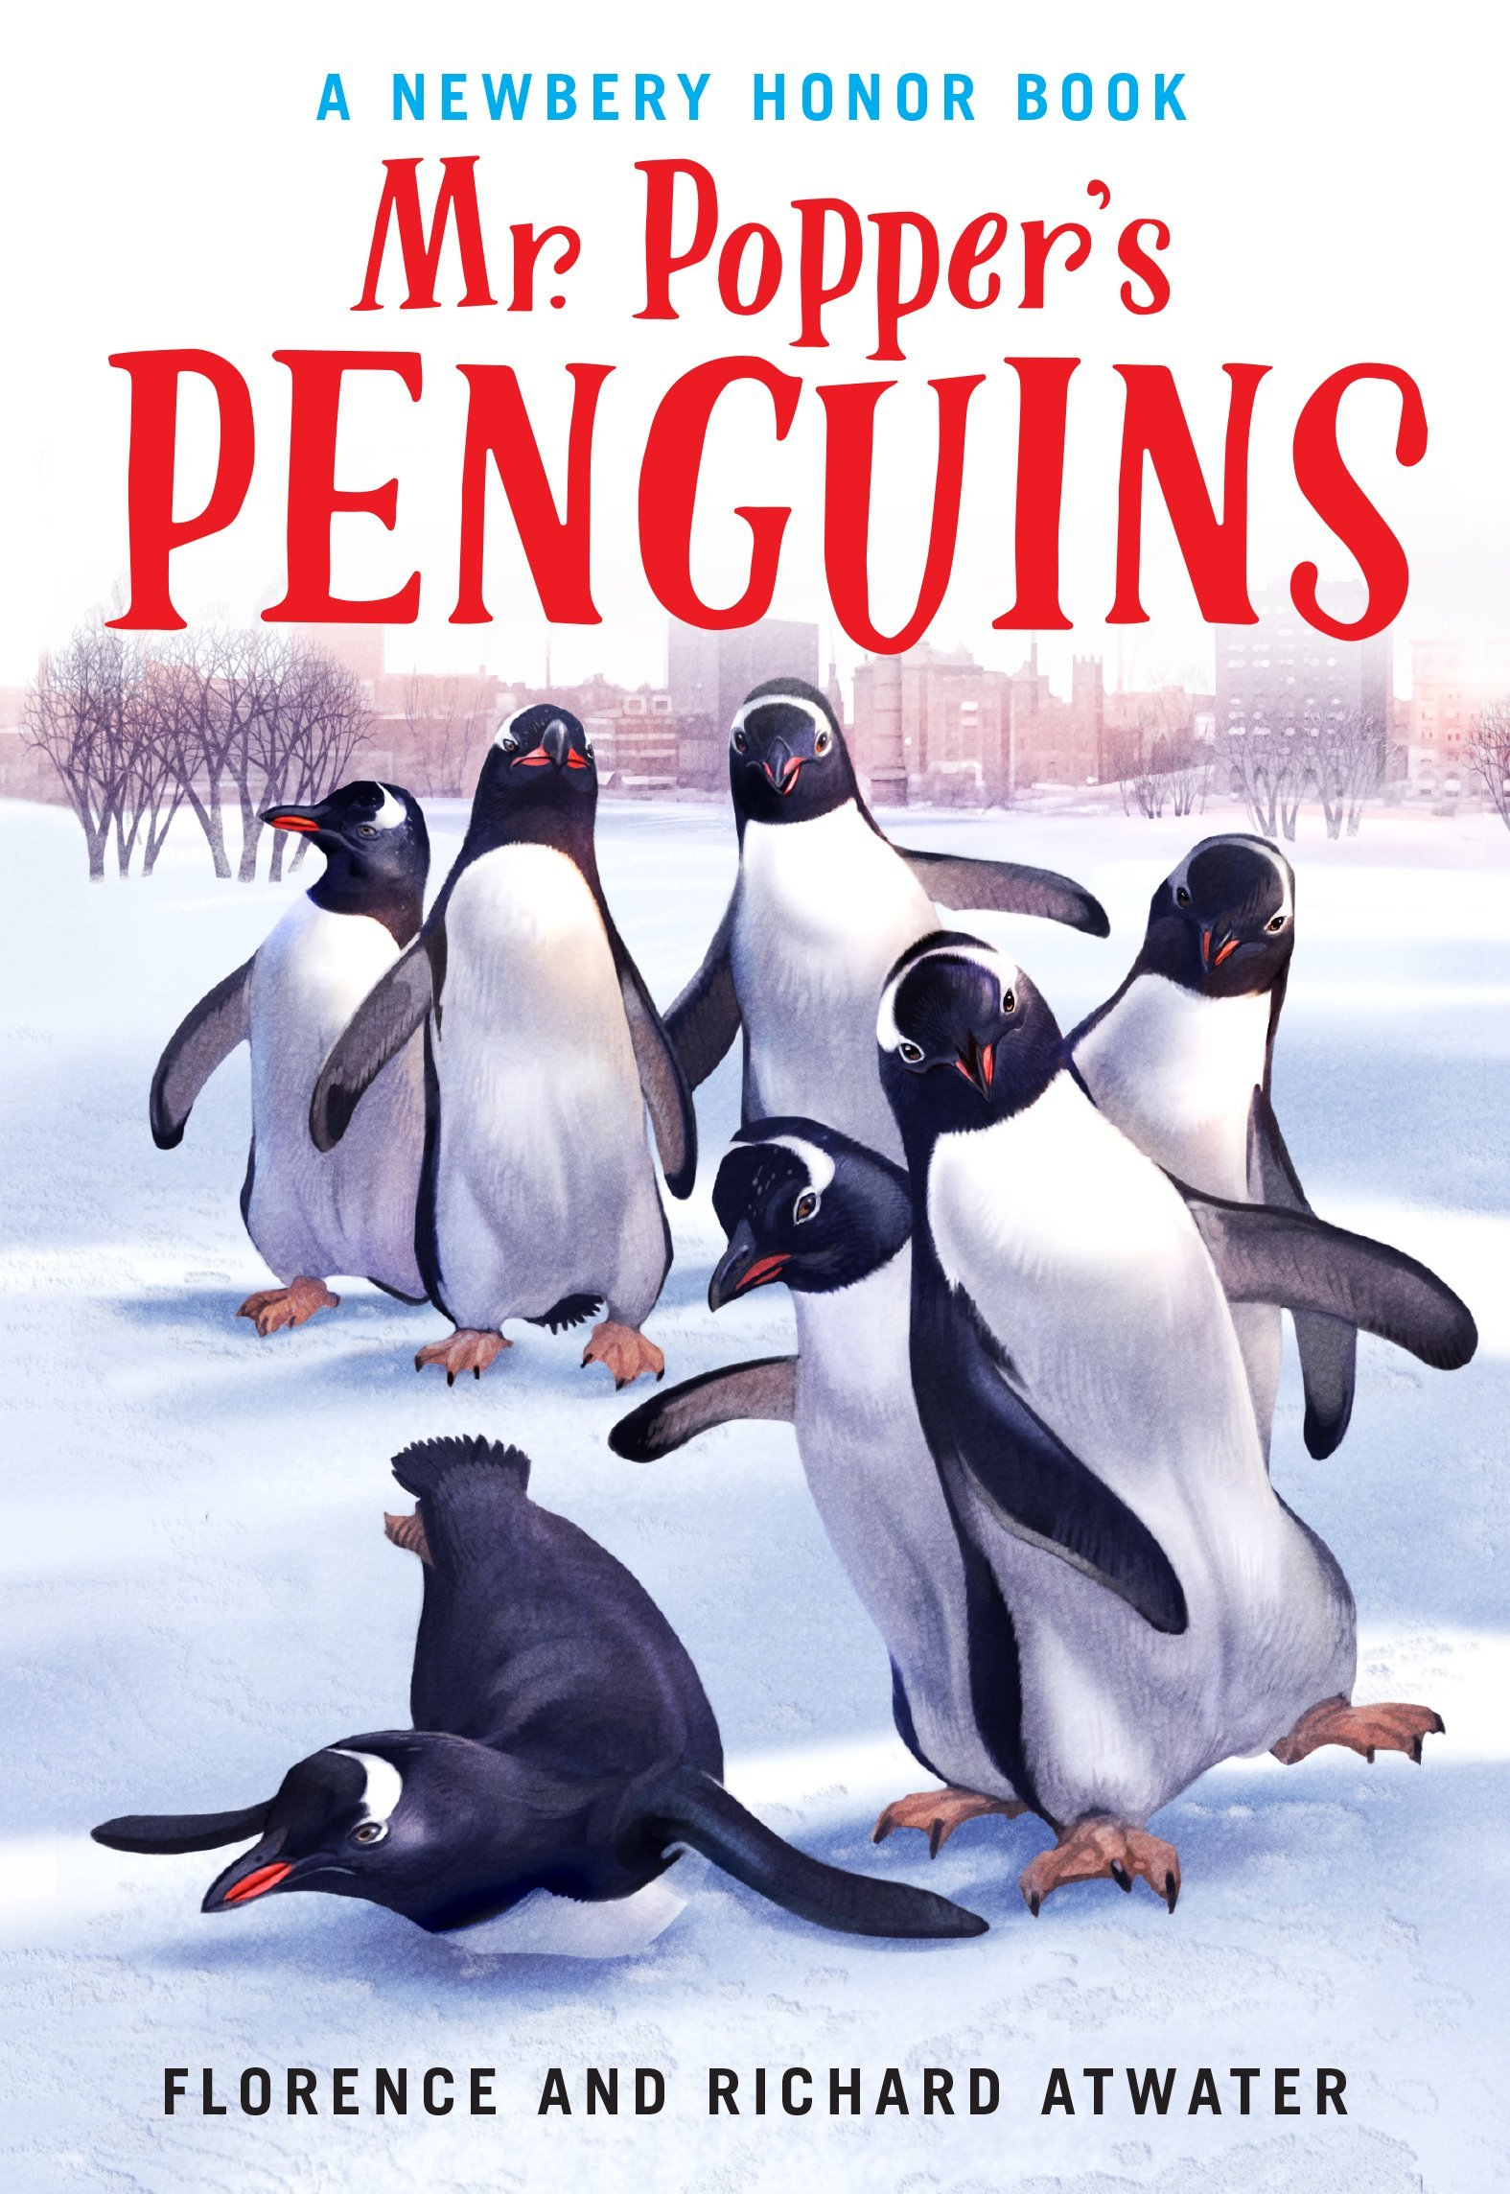
MR POPPER’S PENGUINS CHAPTER 7

Slide 7
CAPTAIN COOK BUILDS A NEST
What do you think is going to happen in this chapter?
Why would Captain Cook want to build a nest?
Why do animals have nests?
How do you think a penguin could build a nest?

Slide 8
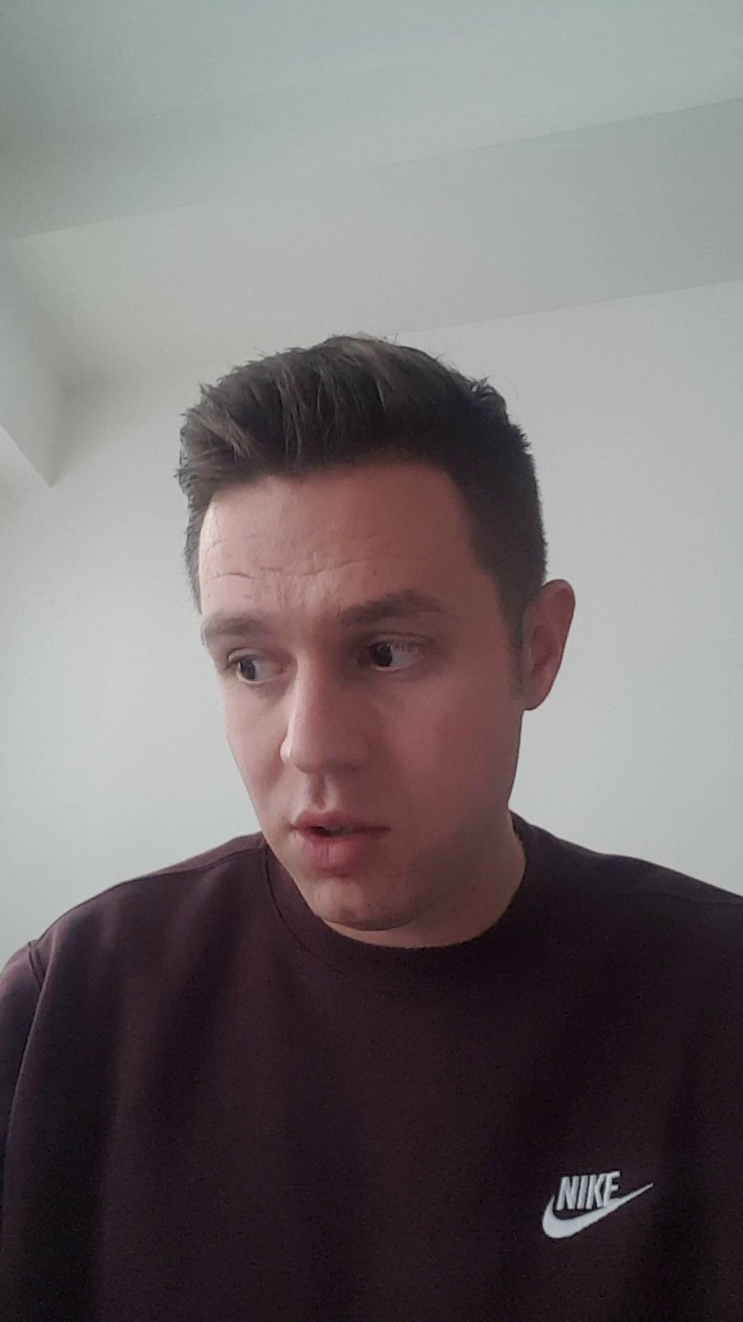

Slide 9
PAGE 43 - 45
Read through the text (2.32 mins of audio book)
Highlight any words that you find difficult (try to find 10)
Highlight adjectives

Slide 11
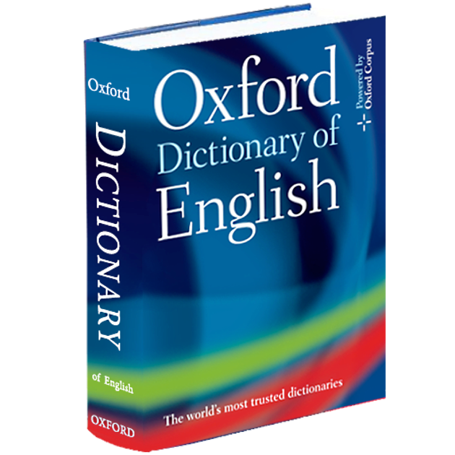
DICTIONARY
Get a dictionary or use google search and try to find the meanings to the difficult words you found.
You can write a short definition next to the word on the page.

Slide 12
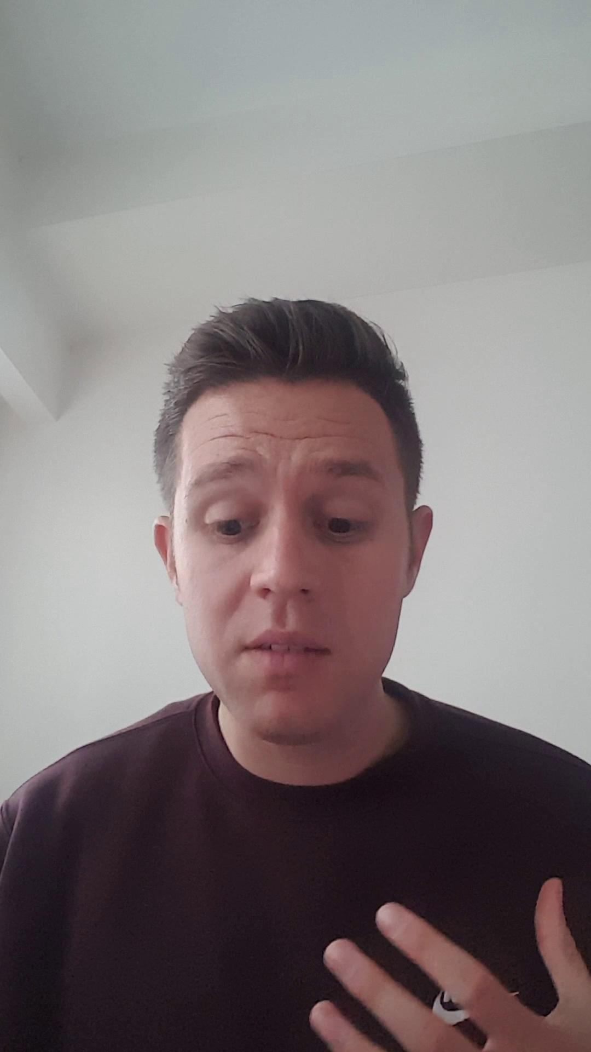

Slide 13
PICTURE PERFECT!
Draw a picture on the blank paper of Captain Cook waddling around the house.
Next to the drawing, label the different items you have drawn in the house.
Colour in!

Slide 15
QUESTIONS TO THINK ABOUT
Using some lined paper, try to answer the following questions in complete sentences:
Why was Mr Popper now shaving and trying to make himself look neat?
Why did Mrs Popper have to be a good housekeeper?
Do you think Captain Cook was helping Mrs Popper with the tidying of the house? Explain why or why not.
How did Mrs Popper feel at first when she saw what Captain Cook had done now?

